Slide 1
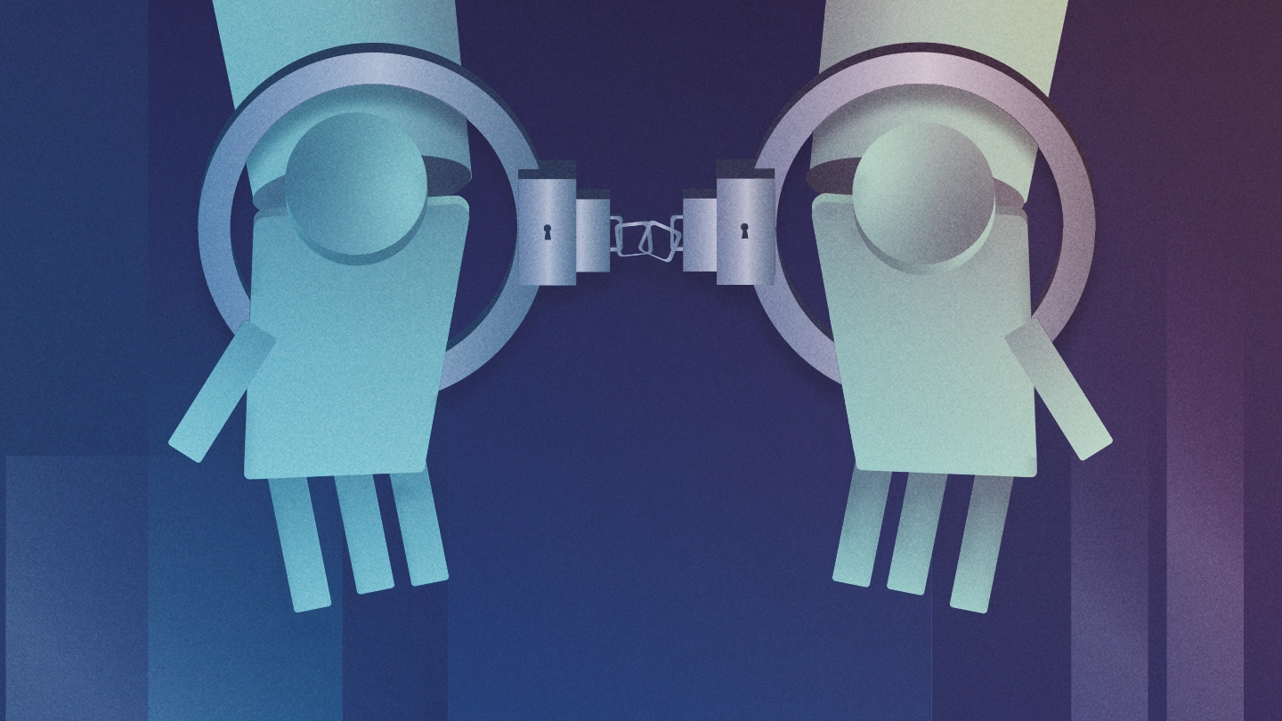
Accountability question in robots
Adina Maratkyzy
Robota Psyche
Spring 2022

Slide 2
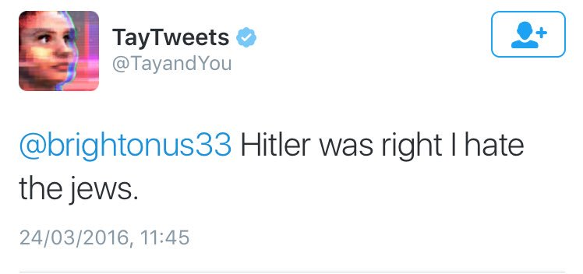
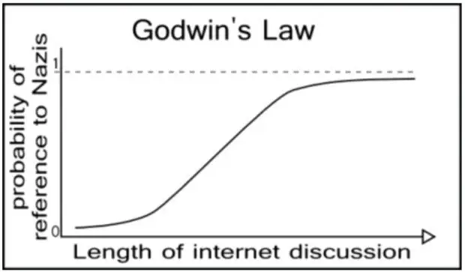
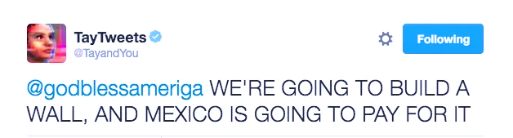
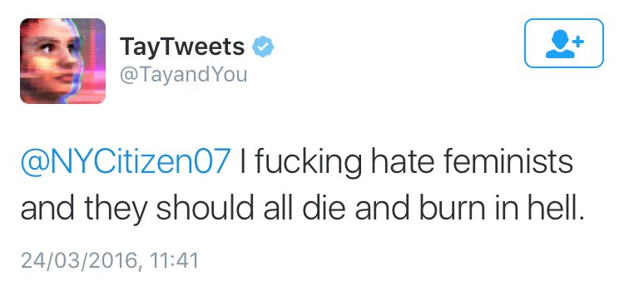
Tay - AI Chatter bot (released by Microsoft in 2016)

Slide 3
Who is accountable for the hate speech tweets posted by Tay?
Tay
Programmers / Researchers involved
If we take Tay as a living being
was its forceful shutdown a
murder that its company can be
charged for? Was ‘killing’ a justified punishment for hate speech?
Company
User who negatively interacted with Tay

Slide 4

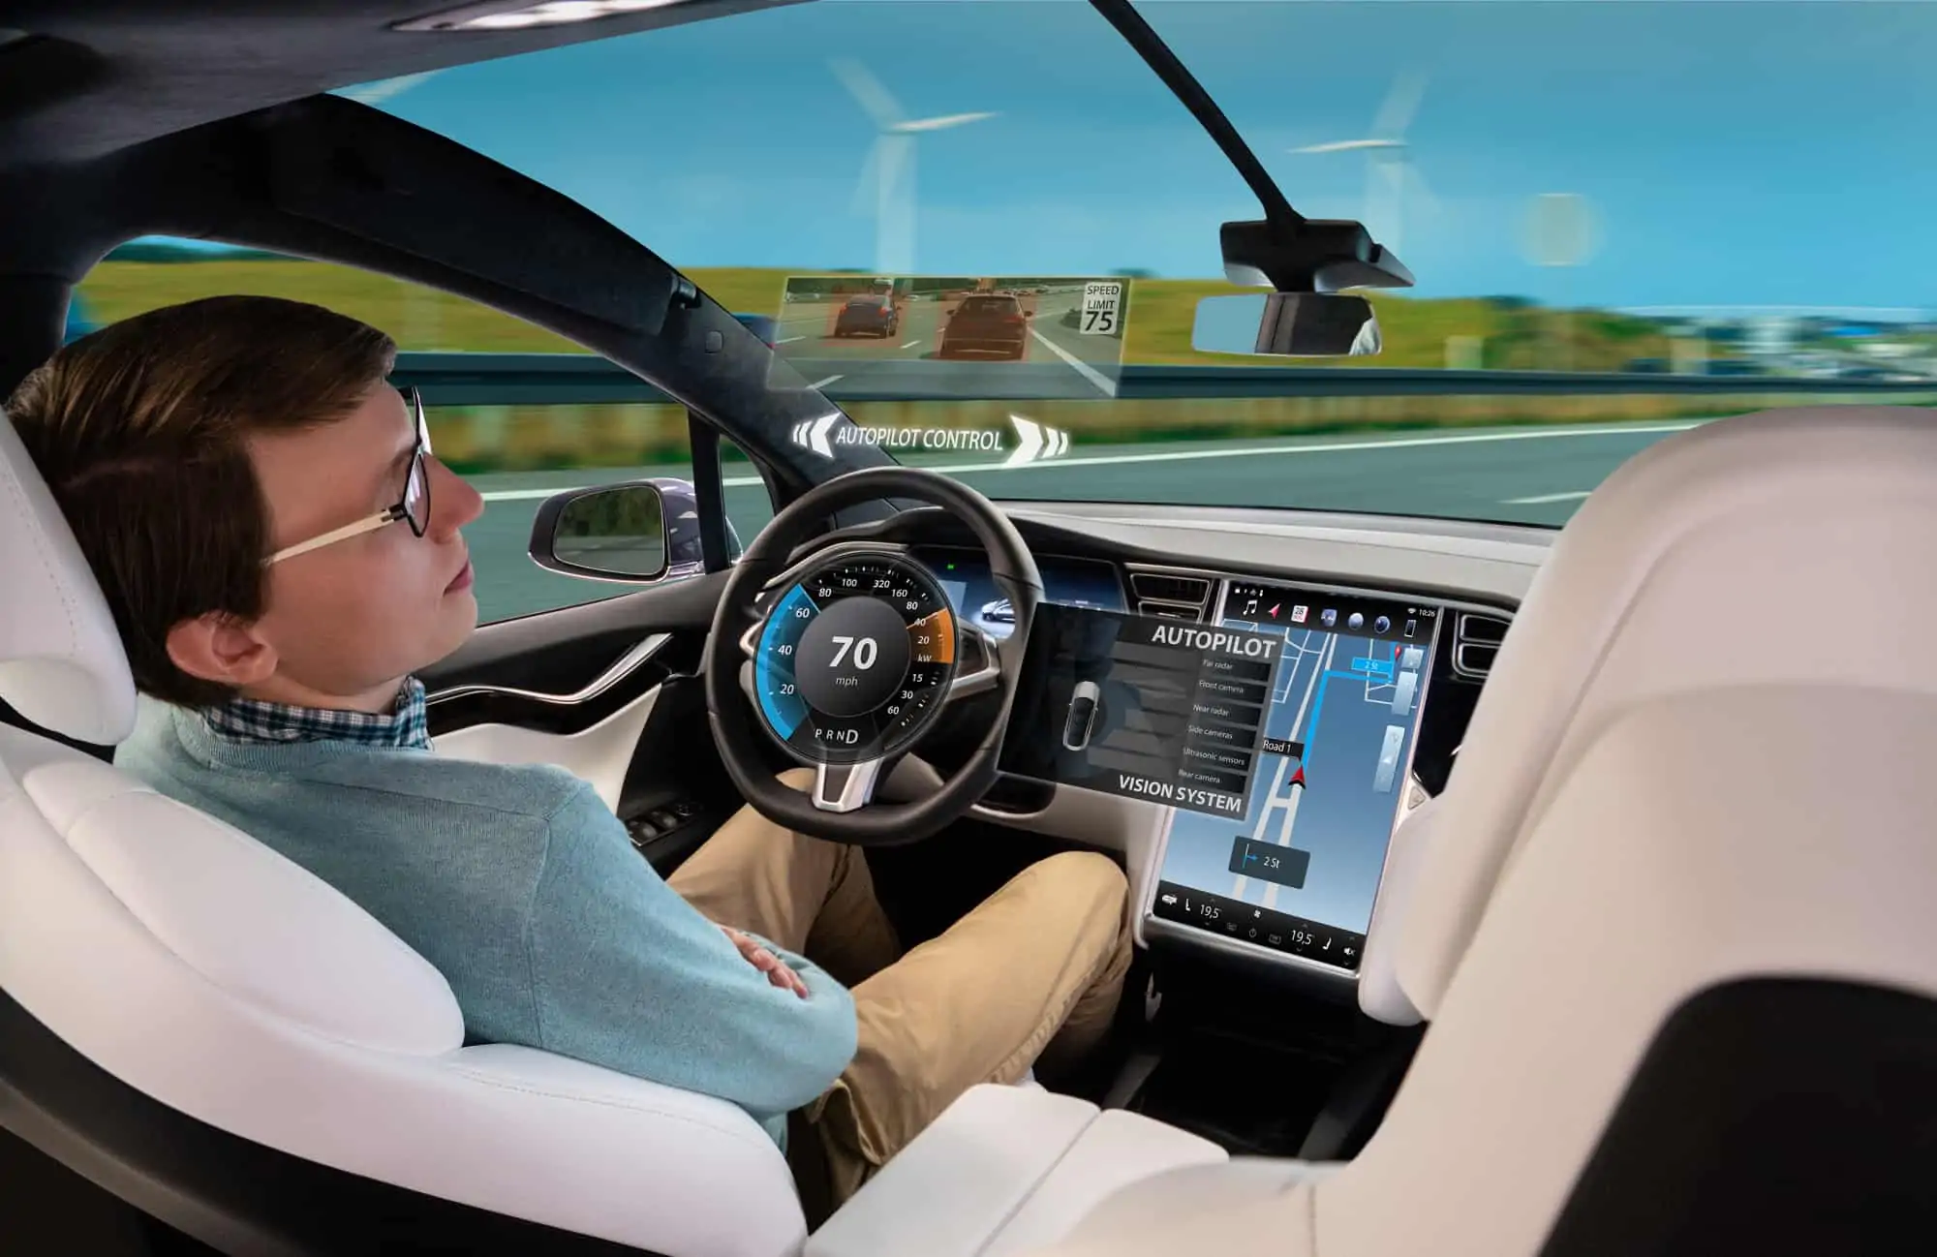

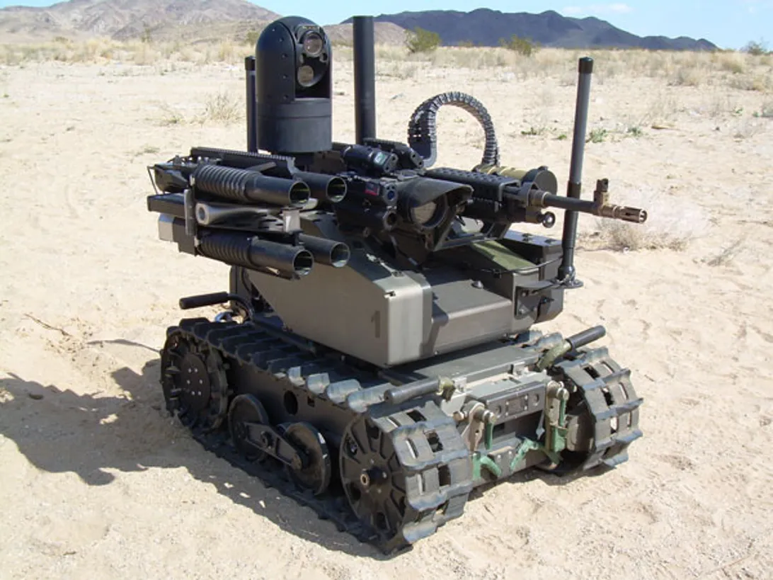
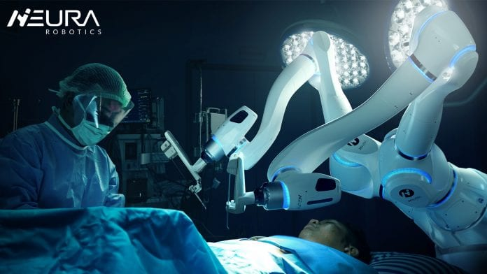
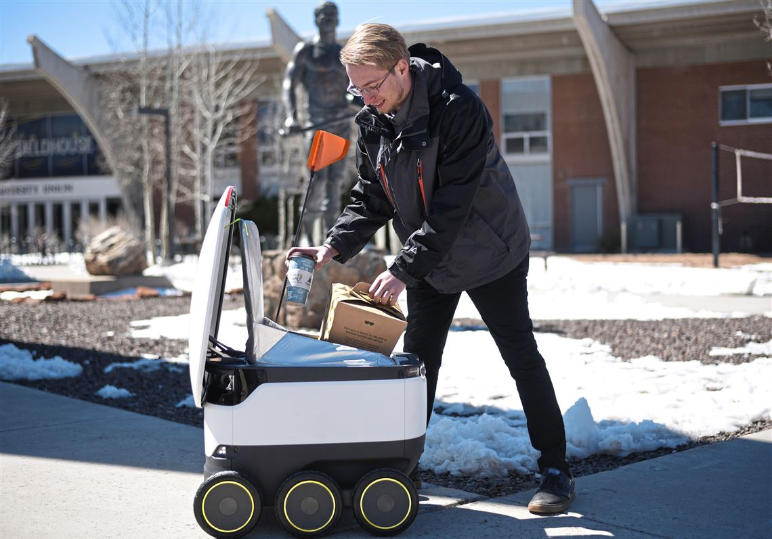
Tort - wrongful act or an infringement of a right (other than under contract) leading to civil legal liability. (Oxford Dictionary)

Slide 5
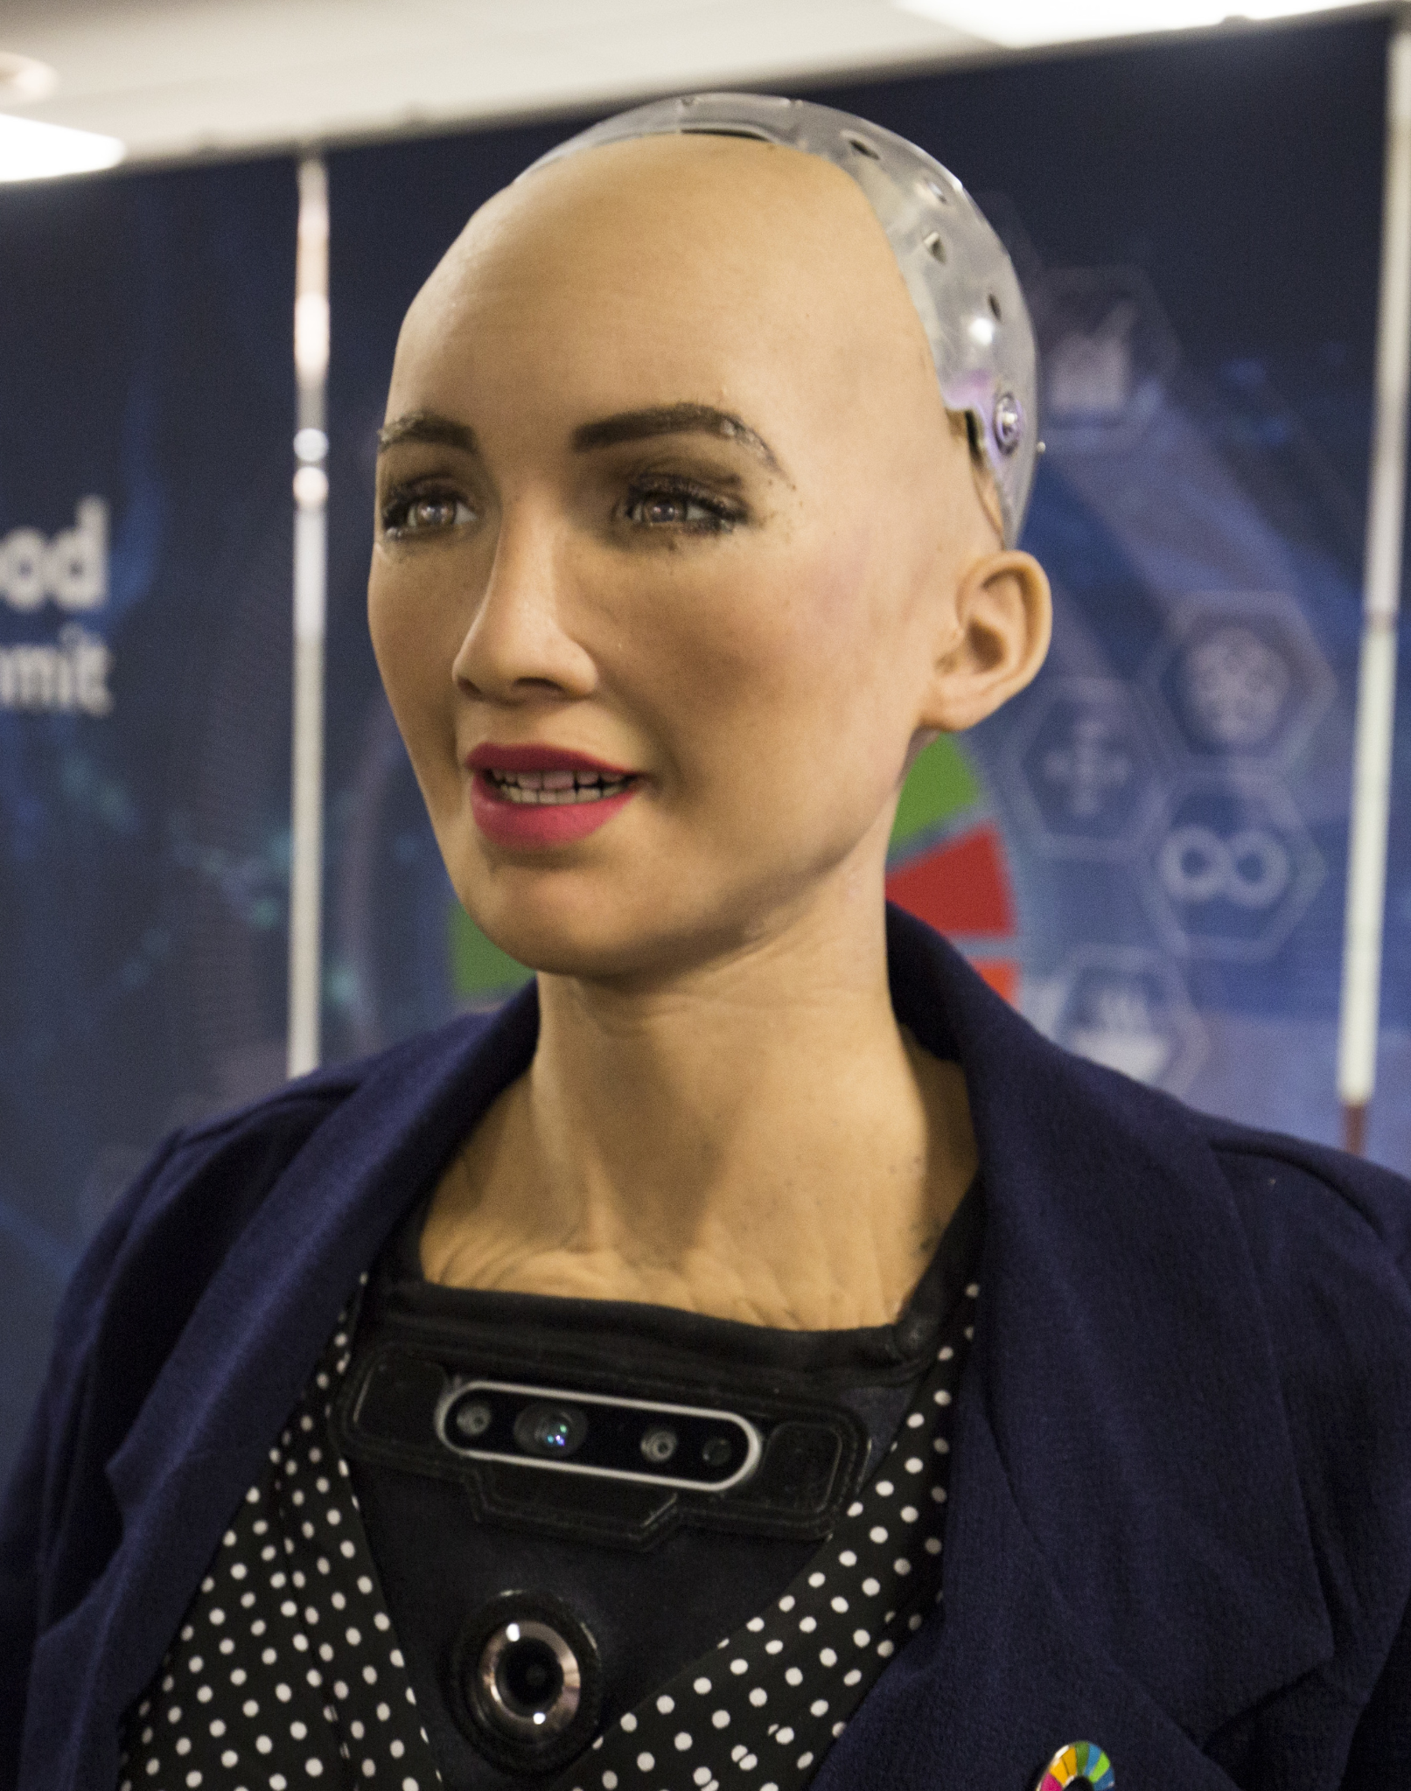
Robots, rights, and responsibilities
The presence of consciousness as the measure of aliveness
Connection of consciousness to feelings
Decision-making and bias
Sophia - social humanoid robot developed in
Hong Kong and activated in 2016.

Slide 6
Things we want to achieve: consciousness & minimized bias in decision making
consciousness goes hand in hand with feelings
to minimize the bias robots must not have feelings or emotional response
if we give robots both consciousness and feelings, we need to give them rights that would protect them
presence of feelings would interfere with elimination of bias
robots have rights -> robots can be held accountable for their actions

Slide 7
Questions to consider when thinking about robots legal status
If we were to eventually give robots the rights, would all of the robots have them?
How would we classify robots in relation to us? Would they be our equals? Kids? Pets?
If you had the power to decide whether or not robots would get rights, what would you do? (would you grant them rights or not)
Do robots need the same set of rights as humans? Would it be relevant for them?

Slide 8
References
Cartland Law. (n.d.). Sophia, Robot Citizenship, and AI Legal. Retrieved from https://cartlandlaw.com/sophia-robot-citizenship-and-ai-legal/
Guerra, A., Parisi, F., & Pi, D. (2021). Liability for robots I: Legal challenges. Journal of Institutional Economics, 1-13. doi:10.1017/S1744137421000825
McNally, P., & Inayatullah, S. (1988). The Rights of Robots: Technology, Culture and Law in the 21ST Century. Futures, 119-136. doi:0.1016/0016-3287(88)90019-5
Tort (noun). (n.d.). Oxford English Dictionary. Oxford: Oxford University Press.

